Slide 1
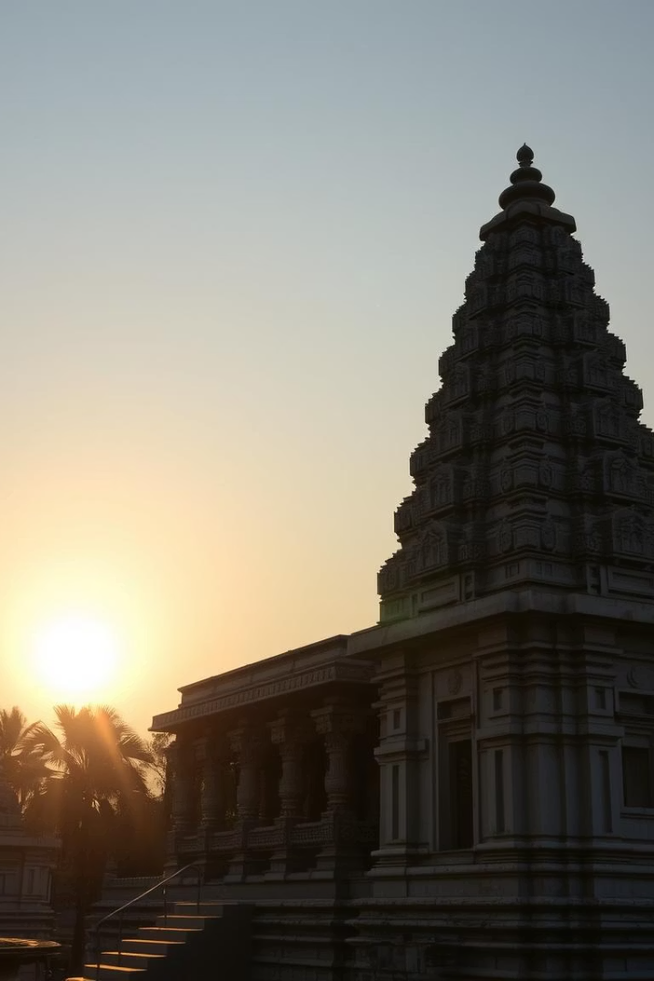
THE GREAT LIVING
CHOLA TEMPLES
Prepared By: Jenish Badarshahi
Class – 12

Slide 2
INDEX
Location
Glimpse into history
Architectural grandeur
Specialities of temples
Exploration of temples
Bibliography

Slide 3
LOCATION
Geography
Travel Route
The temples are located in Tamil Nadu, southern India.
Porbandar to Rajkot by rail or road
Fly from Rajkot to Chennai
Distance from Porbandar is about 2,200 kilometers.
Continue by road or rail to temple sites
Main temples: Thanjavur, Gangaikonda Cholapuram, Darasuram

Slide 4





A GLIMPSE INTO HISTORY
Chola Dynasty Era
Ruled from 9th to 13th century CE in South India.
Golden Age Rulers
Raja Raja I and Rajendra I led political and cultural expansion.
Cultural Achievements
Maritime power, temple building, and thriving trade networks.
Temple Legacy
Brihadeeswarar Temple commissioned in 1010 CE as a grand imperial symbol.

Slide 5
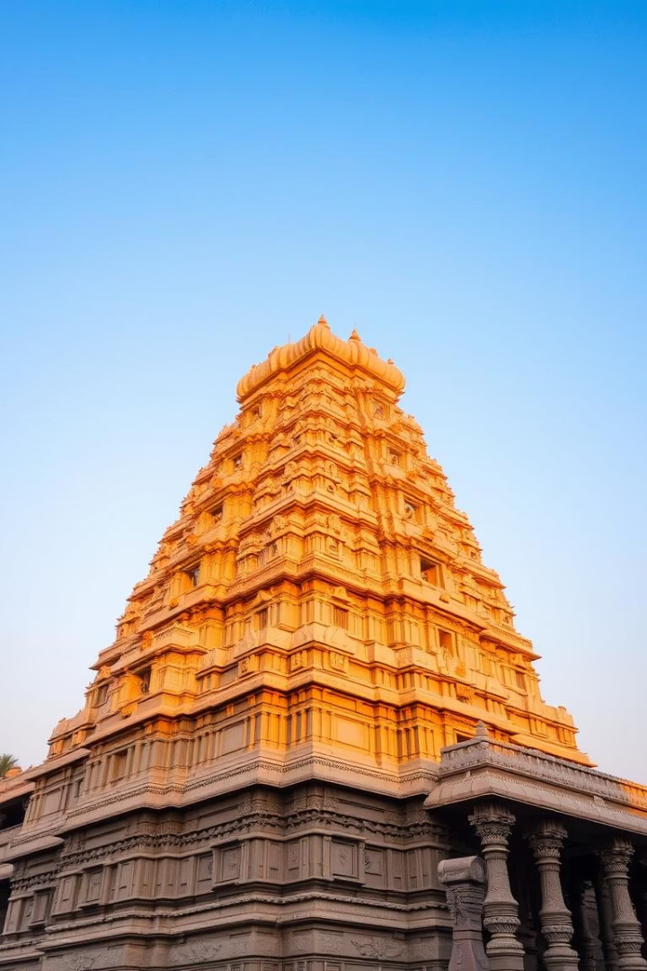

ARCHITECTURAL GRANDEUR
Dravidian Style
Heightened vimanas and elaborate stone carvings define the style.
Engineering Mastery
Massive granite stones assembled without mortar.
Iconic Structures
Brihadeeswarar’s 66-meter vimana is among the tallest of its kind.
Artistic Excellence
The temples reflect Chola’s cultural and imperial ambitions.

Slide 6
SPECIALITIES OF THE TEMPLES
Brihadeeswarar
Gangaikonda Cholapuram
Airavatesvara
World Heritage
Main vimana's shadow never touches ground.
Musical steps produce notes when tapped.
All three are UNESCO World Heritage Sites showcasing art and devotion.
Rich sculptures portraying Chola life and legends.

Slide 7
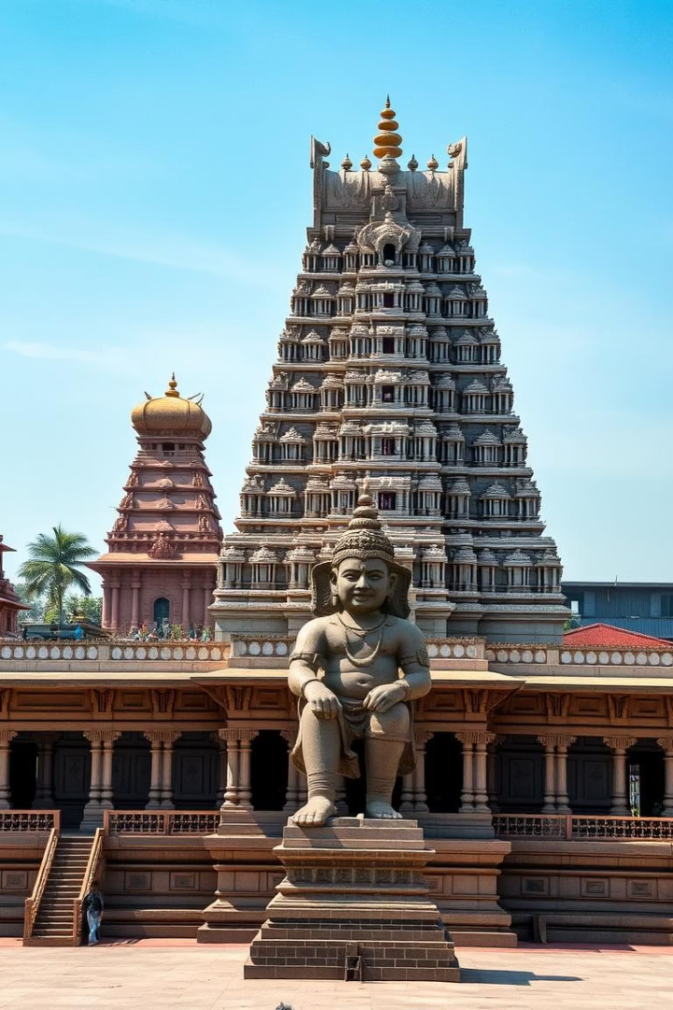
EXPLORATION OF TEMPLES
Brihadeeswarar Temple
Gangaikonda Cholapuram
Dedicated to Lord Shiva with an enormous Nandi bull statue.
Rajendra I’s capital symbolizing his conquests in North India.
Airavatesvara Temple
Smaller but richly detailed shrine dedicated to Lord Shiva.

Slide 8
BIBLIOGRAPHY
Archaeological Survey of India reports
"History and Culture of Tamil Nadu" by Chithra Madhavan
UNESCO World Heritage descriptions
"Early Chola Art" by Douglas Barrett
Research papers from journals like "Artibus Asiae"

Slide 9

THANK YOU
.

